Slide 1
OOPs CONCEPTS

Slide 2
Constructor
A constructor is a special method of the class which gets automatically invoked whenever an instance of the class is created.
Like methods, a constructor also contains the collection of instructions that are executed at the time of Object creation.
It is used to assign initial values to the data members of the same class.

Slide 3
Static Member vs Instance Member
If a variable is explicitly declared by using static modifier or if a variable is declared under any static block then those variables are static. Where rest of other are instance variables.
Static members of a class doesn’t require instance of class for initialization or execution. Where instance members requires instance of a class for both initialization and execution.
Static variables are initialized immediately once the execution of class starts where instance variables are initialized only after creating the class instance.
In the life cycle of a class static variables can be initialized only once where instance variables can be initialized n times if n instances are created

Slide 4
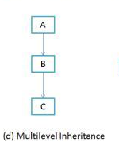
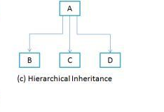
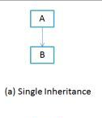
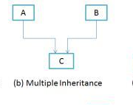
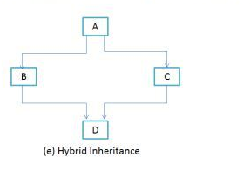
Inheritance
It’s a mechanism of consuming members of one class in another class by establishing parent/child relationship
Types of Inheritance

Slide 5
OOPs Concepts
Encapsulation:This is all about hiding of data while enclosing or wrapping data under the container known as class which provides the basic security for the contain present under the class.
Abstraction: This is all about hiding the complexity of the program and then providing with the set of interface to consume the functionality.
Polymorphism: Behaving in different ways depending upon the input that is received is known as polymorphism, i.e. whenever the input changes automatically the output or behavior also changes.

Slide 6
Method Overloading
Method overloading allows programmers to use multiple methods with the same name. The methods are differentiated with their number and type of method arguments. Method overloading is an example of the polymorphism feature of an object oriented programming language
Method overloading can be achieved by the following:-
1) By changing number of parameters in a method
2) By changing the order of parameters in a method
3) By using different data types for parameters

Slide 7
Method Overriding
Method overriding in C# allows programmers to create base classes that allows its inherited classes to override same name methods when implementing in their class for different purpose. This method is also used to enforce some must implement features in derived classes.
Method overriding is only possible in derived classes, not within the same class where the method is declared.
Base class must use the virtual or abstract keywords to declare a method. Then only can a method be overridden

Slide 8
THANK YOU

